Slide 1
LIVE CAPTURING BASED IMAGE SEGMENTATION USING MASK R-CNN
Under the Supervision of
Mr. K. JEEVAN RATNAKAR _{(M.Tech)}
Presented By:
1) V.VEDASRI (19BQ1A12H6)
2) S.AASRITHA (19BQ1A12D9)
3) V.VENKATA DEEPTHI (19BQ1A12H7)

Slide 2
Contents
Abstract
Introduction with Motivation
Existing System with References
Proposed System with advantages
Software Requirements
Hardware Requirements
7. Functional requirements
8. Non-Functional requirements
9. Mask RCNN System architecture
10. Use Case diagram
11. Sequence diagram
12. Class diagram
13. Activity diagram
14. Modules
15.Test Cases
16. Output Screens
17. Summary

Slide 3
ABSTRACT
Image segmentation is a critical process in computer vision.It involves dividing a visual input into segments to simplify image analysis. Traffic based image segmentation is a technique used to identify and isolate vehicles, pedestrians, and other objects in traffic scenes captured by cameras. The algorithm uses convolutional neural networks to identify objects of interest in traffic scenes and segment them accurately. This project helps in automating the signal change irrespective of time. Though the signal is green in the way in the traffic, if the vehicles are not present, then it's of no use. So, to avoid time wasting, we came up with an idea to implement the current traffic system. After segmenting the image, if no vehicle is present in that way, it automatically changes the green signal to the next mode.

Slide 4
Image segmentation involves dividing a visual input into segments to simplify the image analysis. Segments represents objects or parts of objects and comprise sets of pixels. Image segmentation creates a pixel wise mask for each object in the image this technique gives us far more granular understanding of the image. Image segmentation is typically used to locate objects and boundaries(lines, curves, etc.) in images. More precisely it is the process of assigning a label to every pixel in an image such that pixels with same label share certain characteristics.

Slide 5
EXISTING SYSTEM
Image segmentation originally started from Digital Image Processing coupled with optimization algorithms.
Thresholding
Edge Segmentation
Cluster Based Segmentation

Slide 6
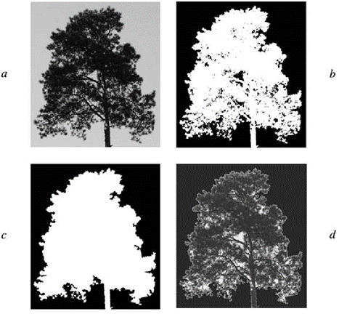
Thresholding
Thresholding is one of the easiest methods of image segmentation where a threshold is set for dividing pixels into two classes. Pixels that have values greater than the threshold value are set to 1 while pixels with values lesser than the threshold value are set to 0.
Limitations:
Threshold selection is not always accurate and might miss the
data.
Difficult in finding the threshold value.

Slide 7
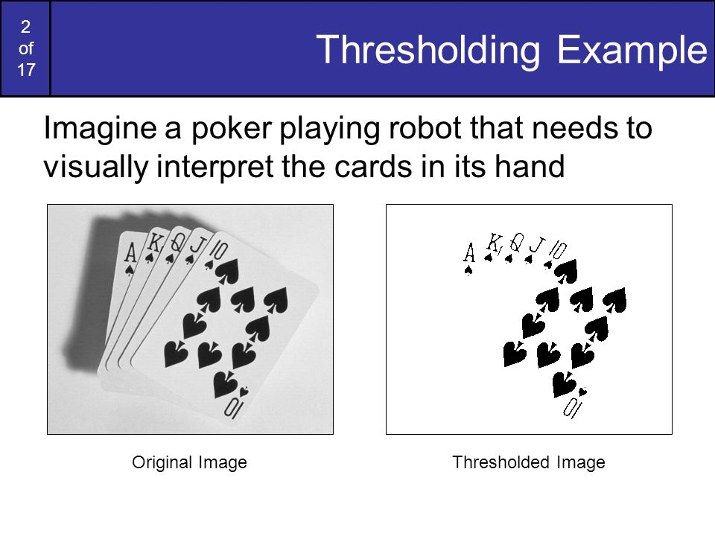

Slide 8
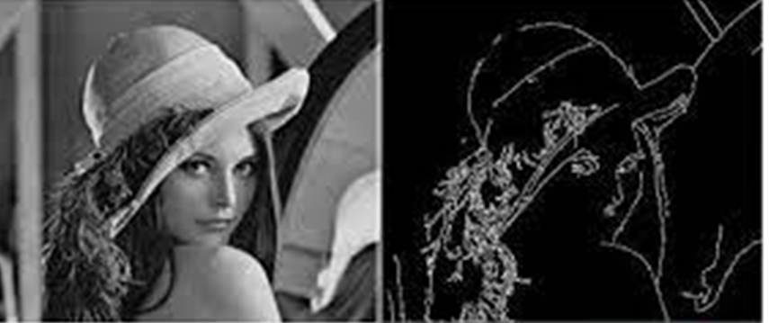
Edge Segmentation
Edge segmentation, also called edge detection, is the task of detecting edges in images. From a segmentation-based viewpoint, we can say that edge detection corresponds to classifying which pixels in an image are edge pixels and singling out those edge pixels under a separate class correspondingly.
Limitations:
Could not be applied on images having many edges.

Slide 9
Clustering Based Segmentation
Clustering algorithms perform better than their counterparts and can provide reasonably good segments in a small amount of time. Popular algorithms like the K-means clustering algorithms are unsupervised algorithms that work by clustering pixels with common attributes together as belonging to a particular segment.
Limitations:
In clustering if the objects are overlapped the clusters cannot be divided properly.

Slide 10
PROPOSED SYSTEM
The target of our project is to apply the Mask R CNN algorithm for image segmentation. There are two levels of image analysis: Classification, Object detection segmentation. Classification: categorizing the entire image into class such as animals, humans, objects. Object detection: detecting objects in an image and drawing a rectangle around them.
Mask R-CNN is a state-of-the-art deep neural network architecture used for image segmentation. Using Mask R-CNN, we can automatically compute pixel-wise masks for objects in the image, allowing us to segment the foreground from the background. Mask R-CNN, can automatically predict both the bounding box and the pixel-wise segmentation mask of each object in an input image.

Slide 11
Functional Requirements
Classification of objects
Object detection
Non-Functional Requirements
Efficiency
Unambiguity
Correctness

Slide 12
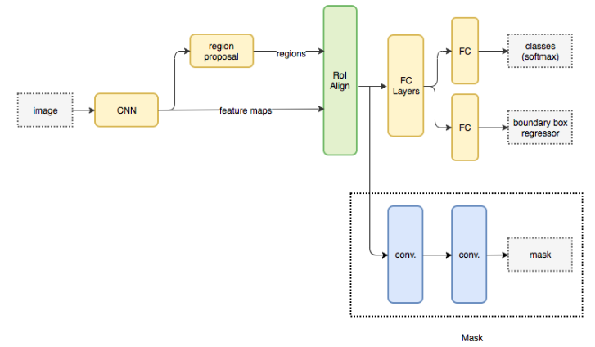
Mask RCNN System Architecture

Slide 13
ADVANTAGES
Simplicity: Mask R-CNN is simple to train.
Performance: Mask R-CNN outperforms all existing, single-model entries on every task.
Efficiency: The method is very efficient and adds only a small overhead to Faster R-CNN.
Flexibility: Mask R-CNN is easy to generalize to other tasks. For example, it is possible to use Mask R-CNN for human pose estimation in the same framework.

Slide 14
SOFTWARE REQUIREMENTS
Python 3.6
Anaconda
Google Coloboratory
HARDWARE REQUIREMENTS
Processor - Intel Core i3 or above
Hard Disk - 5GB or above
Memory - 4GB RAM or above

Slide 15
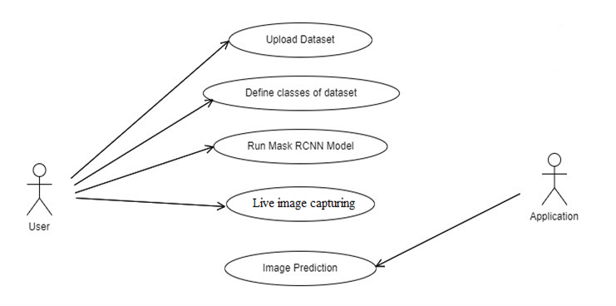
Use Case Diagram

Slide 16
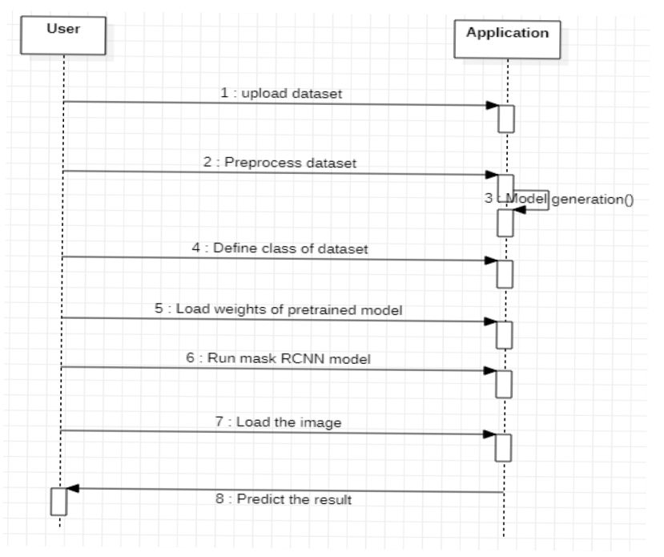
Sequence diagram

Slide 17
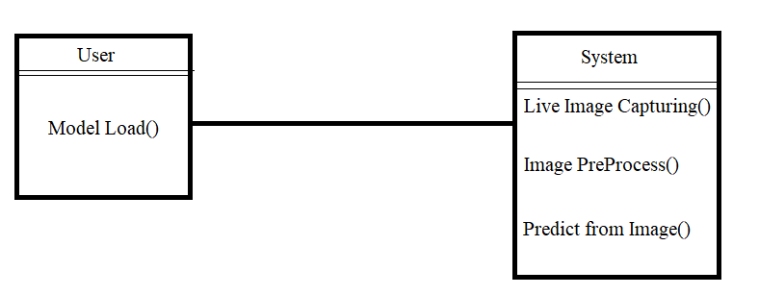
Class diagram

Slide 18
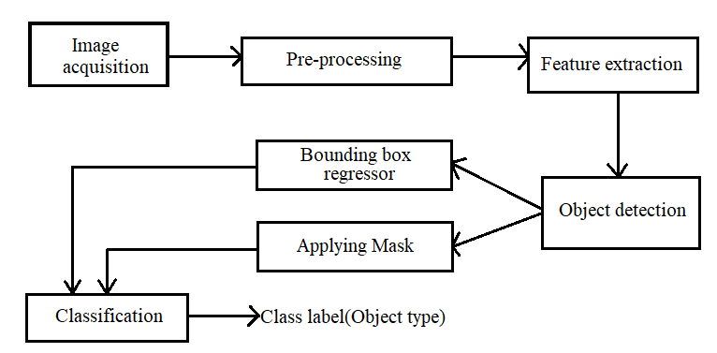


Activity Diagram

Slide 19
Modules
It can be broken down into six major steps :
Setting up the development environment
Collecting Data
Choosing a Model
Training the model
Evaluating the model
Detecting the objects

Slide 20
Setting up the development environment:
Install the required dependencies, including Python, TensorFlow, Keras, NumPy, OpenCV.
Collecting Data :
The dataset Is taken from Kaggle which is provided by author Julia Elliott. In 2019 there is a competition that contains images for image segmentation gathered from all over the world. The dataset contains 99,999 images.

Slide 21
Choosing a model :
Mask R-CNN is the chosen model, which is the extension of faster R-CNN. R-CNN is a region based convolutional neural network. This defines each object with a mask and a bounding box.
Training the model:
Train the Mask R-CNN model on training set using a GPU, and monitor its performance using metrics such as mean average precision (mAP).

Slide 22
Evaluating the model :
mAP stands for mean average precision and is a common metric used to evaluate the performance of object detection and segmentation models, including Mask R-CNN.

Slide 23
Test Cases
S.No | Test Case | Expected Output | Actual Output | Result
1. | Image containing an object | Detection of object and applying bounding box, mask. | Detection of object and applying bounding box, mask. | Pass
2. | Image containing multiple objects | Detection of all the objects and applying bounding box, mask to each and every object separately. | Detection of all the objects and applying bounding box, mask to each and every object separately. | Pass
3. | Image containing zero objects | Does not apply any mask or bounding box. | Did not apply any mask or bounding box. | Pass

Slide 24
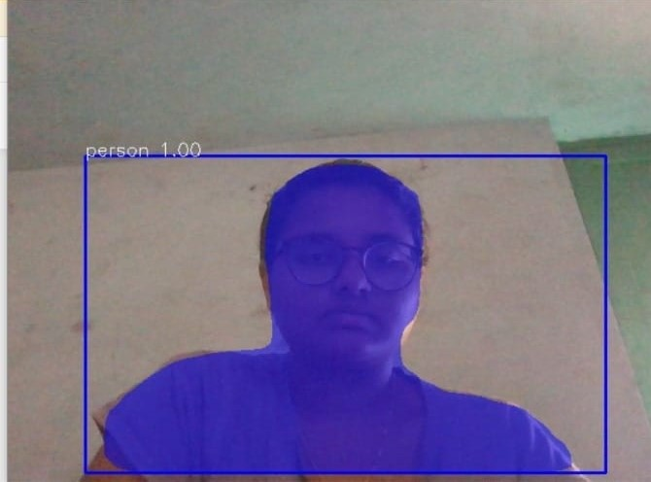
Output Screens

Slide 25
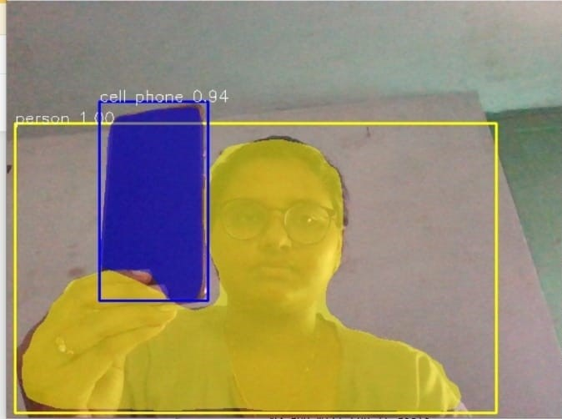

Slide 26
SUMMARY
The proposed system is an image segmentation model with regional convolutional neural network for segmenting pre captured images and live captured images.
The proposed system can be modified to implement in traffic signals, security and self driving cars, shape detection for cancer cells, object detection of satellite images etc.

Slide 27
THANK YOU

